Slide 1
计算机系统结构
第六章 向量处理机

Slide 2
向量处理机
向量处理机是解决数值计算问题的一种高性能计算机结构
向量处理机一般都采用流水线结构，有多条流水线并行工作
向量处理机通常属大型或巨型机，也可以用微机加一台向量协处理器组成
一般向量计算机中包括有一台高性能标量处理机
必须把要解决的问题转化为向量运算，向量处理机才能充分发挥作用

Slide 3
向量处理机
提高流水性能方法：
增加流水线段数，以减少Δt；
每个时钟同时启动多条指令；
减少相关，减少功能变换次数，增加处理指令条数。
向量操作特点
1.向量元素间操作相互独立，且为相同操作。
2.相当于标量循环，对指令带宽的访问要求不高。
3.可采用多体交叉存储器，减少访存延迟。
向量操作很适合于流水处理或并行处理。
Notes:
源、目的REG（偏移量）不同
向量处理：+、-、*、/、点积、逻辑、移位、矩阵等

Slide 4
6.1 向量处理的基本概念
  什么是向量处理
例如：一个简单的C语言程序如下：
for (i = 1; i <n; i++){
a[i] = b[i] +c[i] ;
b[i] =2*a[ i+1] ;
}
在标量处理机上用下述指令实现：

Slide 5
A、B、C分别是向量a、b、c在内存中的起始地址：
INITIALIZE I=1
if (i>N ) GOTO 20
read b[I]
read c[I]
add b[I]+c[I]
store a[I]←b[I]+c[I]
read a[I+1]
multiply 2*a[I+1]
store b[I] ←2*a[I+1]
increment I ←I+1
goto 10
Stop
常量2，a,b,c中每一个元素都称为一个标量。该指令序列称为标量指令序列，执行过程为标量处理过程，每一条指令只处理一个或一对数据。

Slide 6
上述程序用向量化指令序列实现为：
a[1:n]=b[1:n]+c[1:n]
temp[1:n]=a[2:n+1]
b[1:n]=2*temp[1:n]
Vector - a set of scalar data items, all of the same type, stored in memory
Vector processor - an ensemble of hardware resources, including vector registers, functional pipelines,
processing elements, and register counters
for performing vector operations
Vector processing occurs when arithmetic or
logical operations are applied to vectors

Slide 7
向量处理方式
根据向量运算的特点和向量处理机的类型选择向量的处理方式。
有三种处理方式：
1．横向处理方式，又称为水平处理方式，横向加工方式等。向量计算是按行的方式从左至右横向地进行。
2．纵向处理方式，又称为垂直处理方式，纵向加工方式等。向量计算是按列的方式自上而下纵向地进行。
3．纵横处理方式，又称为分组处理方式，纵横向加工方式等。横向处理和纵向处理相结合的方式。
以一个简单的C语言编写的程序为例，说明向量的三种处理方式的工作原理。
for (i = 1；i <= n；i++)
y[i] = a[i] ×( b[i] + c[i] );

Slide 8
横向处理方式
也称为水平处理方式，横向加工方式等
逐个分量进行处理：假设中间结果为T[I]
计算第1个分量： T[1] ＝B[1]＋C[1] Y[1] ＝A[1]×T[1]
计算第2个分量： T[2] ＝B[2]＋C[2] Y[2] ＝A[2]×T[2]
……
最后一个分量： T[N] ＝B[N]＋C[N] Y[N]＝A[N]×T[N]
存在两个问题：
在计算向量的每个分量时，都发生写读数据相关。流水线效率低
如果采用多功能流水线，必须频繁进行流水线切换
横向处理方式对向量处理机不适合
即使在标量处理机中，也经常通过编译器进行指令流调度。

Slide 9
纵向处理
也称为垂直处理方式，纵向加工方式等
T[1] = B[1] + C[1]
T[2] = B[2] + C[2]
……
T[n] = B[n] + C[n]
Y[1] = A[1]×T[1]
Y[2] = A[2]×T[2]
……
Y[N] = A[N] ×T[N]
采用向量指令只需要2条：
VADD B， C， T
VMUL A， T， Y
这种处理方式适用于向量处理机，
  数据相关不影响流水线连续工作。不同的运算操作只需要切换1次。

Slide 10
纵横处理方式
将长度为n的向量分成若干组，每组长度为m，组内按纵向方式处理，依次处理各组。
用于寄存器-寄存器结构的向量处理机中
向量寄存器的长度是有限的，例如，每个向量寄存器有64个寄存器。当向量长度N大于向量寄存器长度n时，需要分组处理。
分组方法：n＝Ｋ·m＋ｒ，其中：ｒ为余数，共分Ｋ＋１组。
组内采用纵向处理方式，组间采用横向处理方式。因此，也称为分组处理方式，纵横向加工方式等。

Slide 11
Styles of Vector Architectures
Memory-memory vector processors
  All vector operations are memory to memory
Vector-register processors
  All vector operations between vector registers (except vector load and store)
  Vector equivalent of load-store architectures
  Includes all vector machines since late 1980s
  We assume vector-register for rest of the lecture

Slide 12
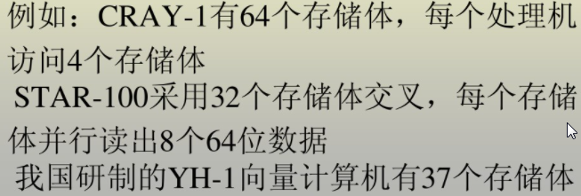
存储器－存储器结构
  下图说明一个具有8个存储体的向量处理机：多体交叉+并行访问
三条互相独立的数据通路，可并行工作，同一个存储模块同时只能为一个通路服务
M
M
M
M
A
流水结构加法器
M
M
B
C=A+B
M
M

Slide 13
向量处理示例1：求C=A+B，设A、B、C的存储形式如图：
模块0
A[0]
B[6]
C[4]
……
模块1
A[1]
B[7]
C[5]
……
模块2
A[2]
B[0]
C[6]
……
模块3
A[3]
B[1]
C[7]
……
模块4
A[4]
B[2]
C[0]
……
模块5
A[5]
B[3]
C[2]
……
模块6
A[6]
B[4]
C[3]
……
模块7
A[7]
B[5]
C[4]
……
A、B、C在主存储器中的存放情况

Slide 14

流水段4
0
1
2
3
4
5
6
7
流水段3
0
1
2
3
4
5
6
7
流水段2
0
1
2
3
4
5
6
7
流水段1
0
1
2
3
4
5
6
7
M7
RB5
RB5
RA7
RA7
W3
W3
M6
RB4
RB4
RA6
RA6
W2
W2
M5
RB3
RB3
RA5
RA5
W1
W1
M4
RB2
RB2
RA4
RA4
W0
W0
M3
RB1
RB1
RA3
RA3
M2
RB0
RB0
RA2
RA2
W6
M1
RA1
RA1
RB7
RB7
W5
W5
M0
RA0
RA0
RB6
RB6
W4
W4
0 1 2 3 4 5 6 7 8 9 10 11 12
时间（时钟周期）
两个向量在流水线方式下分量相加的时序图

Slide 15

      然而实际情况并非总和上述理想化的情况一样。假如结果向量C的第一个元素C0不是存放在我们想存放的模块M4而是在模块M5，那么将出现存储模块M5的读写冲突。
      在流水线的输入端和输出端增加缓冲器可以消除争用存储器现象。
延迟2个时钟周期
A
主存
储器
可变延迟器
流水结
构加法
器
B
C
可变延迟器
延迟4个时钟周期

Slide 16

流水段4
0
1
2
3
4
5
流水段3
0
1
2
3
4
5
6
流水段2
0
1
2
3
4
5
6
7
流水段1
0
1
2
3
4
5
6
7
M7
RA7
RA7
RB7
RB7
M6
RA6
RA6
RB6
RB6
M5
RA5
RA5
RB5
RB5
M4
RA4
RA4
RB4
RB4
RA8
M3
RA3
RA3
RB3
RB3
RA8
RA8
M2
RA2
RA2
RB2
RB2
RA8
RA8
RB8
M1
RA1
RA1
RB1
RB1
RA8
RA8
RB8
RB8
M0
RA0
RA0
RB0
RB0
RA8
RA8
RB8
RB8
W0
0 1 2 3 4 5 6 7 8 9 10 11 12
存储器发生冲突时两个向量相加的时序图
假设向量A的输入缓冲器延迟两个时钟周期，输出缓冲器延迟4个时钟周期。又假定所有向量都从模块M0开始存放

Slide 17
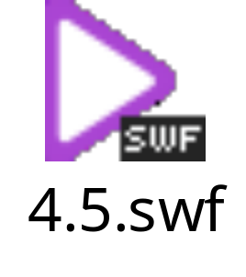
运算器的输入和输出端增加缓冲器以消除争用存储器的方法，本质上与在流水线内部加缓冲器以消除内部冲突的思想是一致的。

Slide 18
寄存器-寄存器结构
使主存有较高带宽的一种方法是形成一个层次结构的存储器系统。当处理器需要向量时，把向量从主存送到速度最快的存储器。运算结果也先送到速度最快的中间存储器。
中间存储器起着数据的中间存储作用，功能上相当于寄存器，因此称为寄存器-寄存器型向量处理机。
把存储器-存储器结构中的缓冲栈改为向量寄存器，运算部件需要的操作数从向量寄存器中读取，运算的中间结果也写到向量寄存器中。
向量寄存器与标量寄存器的主要差别是：
    一个向量寄存器能够保存一个向量，例如：64个64位寄存器。
    连续访问一个向量的各个分量。
    需要有标量寄存器和地址寄存器等。
采用寄存器-寄存器结构的主要优点：降低主存储器的流量。例如：采用寄存器-寄存器结构的CRAY-1与采用存储器-存储器结构的STAR-100比较，运算速度高3倍多，而主存流量低2.5倍。
STAR-100的主存储器流量：32×8W/1.28us=200MW/S
CRAY-1的主存储器流量： 4W/50ns=80MW/S

Slide 19

主存
储器
8MB
64个
个体
8个向量寄存器
8×64×64
12个
流水
线结
构的
运算
部件
缓冲寄存器
64×64
标量寄存器
8×64
缓冲寄存器
64×24
地址寄存器
8×24
指令缓冲寄存器
256×16
CRAY-1向量处理机结构

Slide 20
1 向量运算
对于向量运算来说，中间存储器是8个向量寄存器(V)，每个向量寄存器有64个分量，每个分量为一个64位寄存器。向量指令能对向量寄存器的分量进行连续的重复处理。执行向量指令时，流水结构运算器在一个时钟周期内从两个V寄存器得到一对操作数，完成某种操作后用一个时钟周期时间把结果送入另一个V寄存器。注意，此处的向量运算流水线是从向量寄存器而不是从主存储器获得数据。同样，从流水线输出的结果向量也是送回向量寄存器。而另一方面，主存储器与V寄存器之间的数据传送以成组传送方式进行。
2 标量运算
对标量运算来说，有两级中间存储器。速度很快的一级是8个64位的S寄存器，它是标量寄存器。它们直接与标量运算流水线相连，为标量运算和逻辑运算提供源寄存器和目标寄存器。另一级中间存储器是T寄存器。它由64个标量寄存器组成，每个寄存器字长64位。主存与T寄存器之间以成组传送方式进行数据交换。
3 中间存储器的优点
这种中间存储器与Cache相比的一大优点是速度快。因为CRAY-1流水运算器通过寄存器寻址方式访问中间存储器，而访问Cache必须查Cache表，这需要较长时间。
CRAY-1系统还有8个24位的A寄存器，它主要用作访问存储器的地址寄存器和变址寄存器，还可用来提供移位的计数值和循环控制值。64个24位的B寄存器用作A寄存器的中间存储器，它可以存放需要重复访问的数据。主存储器与B寄存器之间的数据传送以成组传送方式进行。这样，B寄存器组就相当于A寄存器组的Cache。不过对B寄存器的所有操作都是由程序指令直接控制，而不像cache那样是自动控制的。

Slide 21
Basic Vector Architecture
Vector processor typically consists of
  Ordinary pipelined scalar unit
  Add a vector unit that can deal with FP or Integers
Generally use a vector-register processor
  All vector operations except load/store are among vector register. (vector-memory would go to mem)
  Advantages the same as our load/store uniprocessor reasons

Slide 22
Components of a Vector Processor
Scalar CPU: registers, datapaths, instruction fetch logic
Vector register
  Fixed length memory bank holding a single vector
  Has at least 2 read and 1 write ports
  Typically 8-32 vector registers, each holding 1 to 8 Kbits
  Can be viewed as array of 64b, 32b, 16b, or 8b elements
Vector functional units (FUs)
  Fully pipelined, start new operation every clock
  Typically 2 to 8 FUs: integer and FP
  Multiple datapaths (pipelines) used for each unit to process multiple elements per cycle
Vector load-store units (LSUs)
  Fully pipelined unit to load or store a vector
  Multiple elements fetched/stored per cycle
  May have multiple LSUs
Cross-bar to connect FUs , LSUs, registers

Slide 23
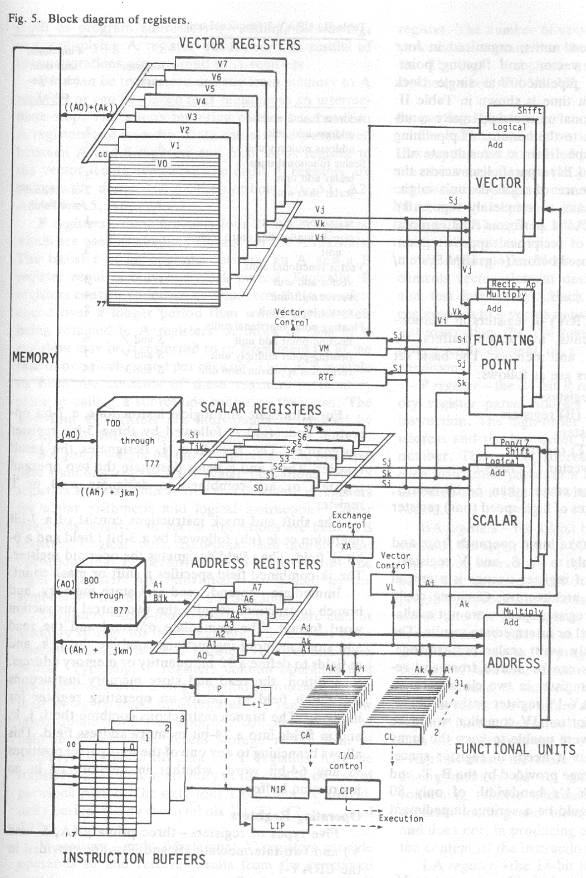
Cray-1
Block
Diagram
Simple 16-bit RR instr
32-bit with immed
Natural combinations of scalar and vector
Scalar bit-vectors match vector length
Gather/scatter M-R
Cond. merge

Slide 24
Basic Vector Instructions
Instr. Operands Operation Comment
VADD.VV V1,V2,V3 V1=V2+V3 vector + vector
VADD.SV V1,R0,V2 V1=R0+V2 scalar + vector
VMUL.VV V1,V2,V3 V1=V2xV3 vector x vector
VMUL.SV V1,R0,V2 V1=R0xV2 scalar x vector
VLD V1,R1 V1=M[R1..R1+63] load, stride=1
VLDS V1,R1,R2 V1=M[R1..R1+63*R2] load, stride=R2
VLDX V1,R1,V2 V1=M[R1+V2i,i=0..63] indexed("gather")
VST V1,R1 M[R1..R1+63]=V1 store, stride=1
VSTS V1,R1,R2 V1=M[R1..R1+63*R2] store, stride=R2
VSTX V1,R1,V2 V1=M[R1+V2i,i=0..63] indexed(“scatter")
+ all the regular scalar instructions (RISC style)…

Slide 25
Vector Memory Operations
Load/store operations move groups of data between registers and memory
Three types of addressing
  Unit stride
    Fastest
  Non-unit (constant) stride
  Indexed (gather-scatter)
    Vector equivalent of register indirect
    Good for sparse arrays of data
    Increases number of programs that vectorize
Support for various combinations of data widths in memory and registers
  {.L,.W,.H.,.B} x {64b, 32b, 16b, 8b}

Slide 26
Vector Code Example
Y[0:63] = Y[0:653] + a*X[0:63]
64 element SAXPY: scalar
LD R0,a
ADDI R4,Rx,#512
loop: LD R2, 0(Rx) MULTD R2,R0,R2 LD R4, 0(Ry)
ADDD R4,R2,R4 SD R4, 0(Ry) ADDI Rx,Rx,#8 ADDI Ry,Ry,#8 SUB R20,R4,Rx BNZ R20,loop
64 element SAXPY: vector
LD R0,a #load scalar a
VLD V1,Rx #load vector X
VMUL.SV V2,R0,V1 #vector mult
VLD V3,Ry #load vector Y
VADD.VV V4,V2,V3 #vector add
VST Ry,V4 #store vector Y

Slide 27
Vector Architecture State
Virtual Processors ($mvl)
VP₀
VP₁
VP_{$mvl-1}
General
Purpose
Registers
vr₀
Scalar
Registers
vr₁
vr₃₁
r₀
$vpw bits
r₁
vf₀
Flag
Registers
(32)
vf₁
r₃₁
64 bits
vf₃₁
1 bit

Slide 28
Vectorization Concepts
Vectorization occurs for operations on arrays
Vectorization occurs in loops (explicit or implicit) of any type
Only innermost loops are vectorized
Data dependencies can inhibit vectorization; results are then computed serially.
Vector registers allow array values to be stored very close the the functional units.
Once vector registers are loaded, operands can be pumped into the functional units (an results generated) every clock period due to pipelining
  Ideally one FU per vector element, but this may be unlikely
Vectorization increases sustained performance by increasing bandwidth of data flow into the functional units.

Slide 29

Two Ways to Vectorization
Inner loop vectorization
  Think of machine as, say, 32 vector registers each with 16 elements
  1 instruction updates 32 elements of 1 vector register
  Good for vectorizing single-dimension arrays or regular kernels (e.g. saxpy)
Outer loop vectorization
  外层循环向量化是一种用于增强性能的技术。最内层循环中的迭代数量较小。此时，对最内层循环进行向量化有些得不偿失。
  Think of machine as 16 “virtual processors” (VPs)
  each with 32 scalar registers! (­ multithreaded processor)
  1 instruction updates 1 scalar register in 16 VPs
  Good for irregular kernels or kernels with loop-carried dependences in the inner loop
These are just two compiler perspectives
  The hardware is the same for both

Slide 30
Outer-loop Example (1)
// Matrix-matrix multiply:
// sum a[i][t] * b[t][j] to get c[i][j]
for (i=1; i<n; i++)
{
for (j=1; j<n; j++)
{
sum = 0;
for (t=1; t<n; t++)
{
sum += a[i][t] * b[t][j]; // loop-carried
} // dependence
c[i][j] = sum;
}
}

Slide 31
Outer-loop Example (2)
// Outer-loop Matrix-matrix multiply:
// sum a[i][t] * b[t][j] to get c[i][j]
// 32 elements of the result calculated in parallel
// with each iteration of the j-loop (c[i][j:j+31])
for (i=1; i<n; i++) {
for (j=1; j<n; j+=32) { // loop being vectorized
sum[0:31] = 0;
for (t=1; t<n; t++) {
ascalar = a[i][t]; // scalar load
bvector[0:31] = b[t][j:j+31]; // vector load
prod[0:31] = b_vector[0:31]*ascalar; // vector mul
sum[0:31] += prod[0:31]; // vector add
}
c[i][j:j+31] = sum[0:31]; // vector store
}
}

Slide 32
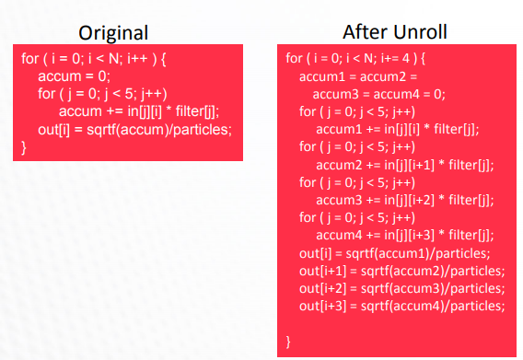
Outer-loop Example
Simple Outer Loop Vectorization
= Loop Unroll-and-Jam + SLP
(Superword-Level Parallelism )

Slide 33
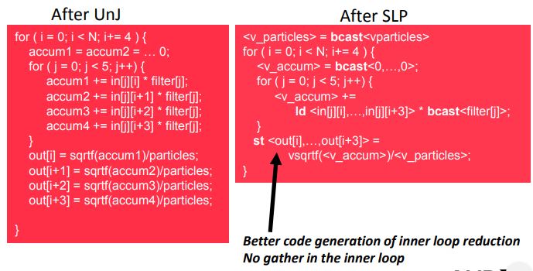
Outer-loop Example
Simple Outer Loop Vectorization
= Loop Unroll-and-Jam + SLP

Slide 34
Vectorization Speedup
Real performance is determined by number of results that can be calculated in functional units per clock period (as in serial computation).
  Convoy : set of instructions that could begin execution in the same clock cycle without hazards
  Chime : execution time for a vector sequence of convoys
  m convoys execute in m chimes; for a vector of length n, approximately m*n clock cycles to complete
Vector registers help sustain high performance by increasing bandwidth to the functional units. Serial computers have trouble keeping the functional units busy.

Slide 35
Vectorization Speedup
Vectorized speedup is limited by vector loads and operations that don’t chain efficiently. Typically see 10x speedup over serial computation of same loop.
  i.e. data hazards cause problems
Most efficient vectors are a multiple N of vector size V; least efficient if vectors are of size N*V + 1 (last vector load not amortized)
  Similar idea to loop unrolling, but with hardware support

Slide 36
Vectorization Inhibitors
Pretty much our list of usual suspects that hurt ILP:
Subroutine and function calls
  but can inline them and perhaps use vectorization
I/O statements
Arithmetic IF, GOTO
Partial word data (character) operations
Unstructured branches
Data dependencies

Slide 37
How Vector Processors Work
An Example
Let’s take a typical vector problem, X and Y are vectors, a is a scalar.
Y = a×X + Y
This is the socalled SAXPY or DAXPY loop that forms the inner loop of the Linpack benchmark.
Example Show the code for MIPS and VMIPS for the DAXPY loop.
Assume that the starting addresses of X and Y are in Rx and Ry. And the number of elements, or length, of a vector register(64) matches the length of the vector operation.
Notes:
SAXPY stands for single-precision a⋅X plus Y; DAXPY for double-precision a ⋅ X plus Y.)
Linpack is a collection of linear algebra routines, and the routines for performing Gaussian elimination constitute what is known as the Linpack benchmark.

Slide 38
Here is the MIPS code.
L.D F0,a ;load scalar a
DADDIU R4,Rx,#512 ;last address to load
Loop: L.D F2,0(Rx) ;load X(i)
MUL.D F2,F2,F0 ;a × X(i)
L.D F4,0(Ry) ;load Y(i)
ADD.D F4,F4,F2 ;a × X(i) + Y(i)
S.D 0(Ry),F4 ;store into Y(i)
DADDIU Rx,Rx,#8 ;increment index to X
DADDIU Ry,Ry,#8 ;increment index to Y
DSUBU R20,R4,Rx ;compute bound
BNEZ R20,Loop ;check if done

Slide 39
Here is the VMIPS code for DAXPY.
L.D F0,a ;load scalar a
LV V1,Rx ;load vector X
MULVS.D V2,V1,F0 ;vector-scalar multiply
LV V3,Ry ;load vector Y
ADDV.D V4,V2,V3 ;add
SV Ry,V4 ;store the result
The most dramatic comparison is that the vector processor greatly reduces the dynamic instruction bandwidth.
Another important difference is the frequency of pipeline interlocks. (Pipeline stalls are required only once per vector operation, rather than once per vector element.)
Notes:
On the vector processor, each vector instruction will only stall for the first element in each vector, and then subsequent elements will flow smoothly down the pipeline.

Slide 40
Vector Arithmetic Execution
V1
V2
V3
Use deep pipeline (=> fast clock) to execute element operations
Simplifies control of deep pipeline because elements in vector are independent (=> no hazards!)
Six stage multiply pipeline
V3 <- v1 * v2
Notes:
The behavior of the load-store vector unit is significantly more complicated than that of the arithmetic functional units.

Slide 41
Vector Load-Store Units and Vector Memory Systems
Operation | Start-up penalty
Vector add | 6
Vector multiply | 7
Vector divide | 20
Vector load / store | 12
Start-up penalties (in clock cycles) on VMIPS
To maintain an initiation rate of 1 word fetched or stored per clock, the memory system must be capable of producing or accepting this much data. This is usually done by spreading accesses across multiple independent memory banks.

Slide 42
Vector Load/Store Units & Memories
•Start-up overheads usually longer for vectorLSUs
•Memory system must sustain (# lanes ⋅word) /clock cycle
•Many VectorProcs. use banks(vs. simple interleaving):
  support multiple loads/stores per cycle => multiple banks & address banks independently
  support non-sequential accesses
Note:No. memory banks > memory latencyto avoid stalls
–mbanks => mwords per memory latencyl clocks
–if m<l, then gap in memory pipeline:
  clock:0…ll+1 l+2…l+m-1l+m…2 l
  word:--…012…m-1--…m
–may have 1024 banks in SRAM

Slide 43
Vector Memory System
Cray-1, 16 banks, 4 cycle bank busy time, 12 cycle latency
  Bank busy time: Cycles between accesses to same bank
Base
Stride
Vector Registers
Address Generator
+
0
1
2
3
4
5
6
7
8
9
A
B
C
D
E
F
Memory Banks

Slide 44
Example
Suppose we want to fetch a vector of 64 elements starting at byte address 136, and a memory access takes 6 clocks. How many memory banks must we have to support one fetch per clock cycle? With what addresses are the banks accessed? When will the various elements arrive at the CPU?
Answer
Six clocks per access require at least six banks, but because we want the number of banks to be a power of two, we choose to have eight banks. Figure on next page shows the timing for the first few sets of accesses for an eight-bank system with a 6-clock-cycle access latency.

Slide 45
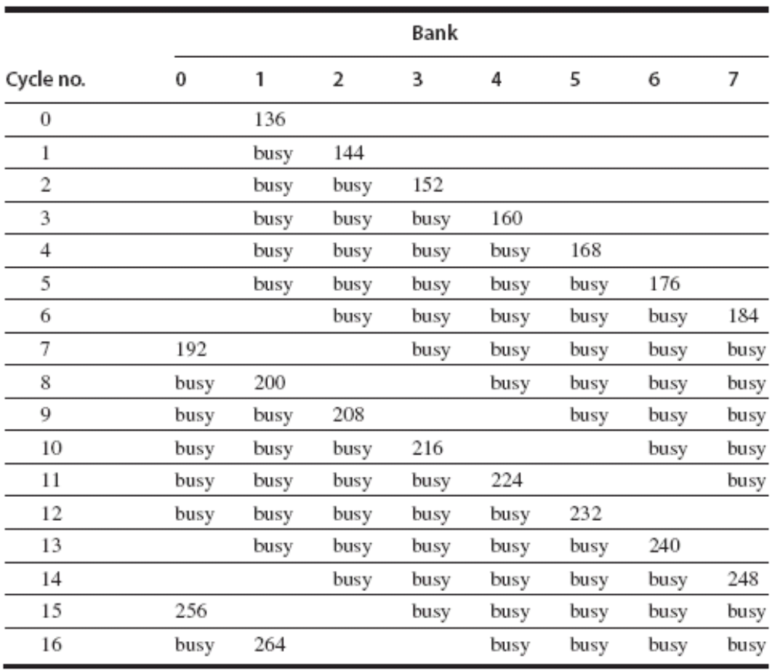
The CPU cannot keep all eight banks busy all the time because it is limited to supplying one new address and receiving one data item each cycle.

Slide 46
Vector Implementation
Vector register file
  Each register is an array of elements
  Size of each register determines maximum vector length
  –Vector-length registerdetermines vector length for a particular operation
Multiple parallel execution units = “lanes”(sometimes called “pipelines”or “pipes”

Slide 47
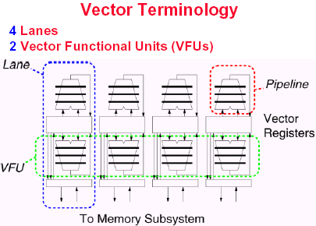

Slide 48
Vector Length
•What to do when vector length is not exactly 64?
•Vector-length register (VLR) Controls the length of any vector operation, including a vector load or store. (cannot be > the length of vector registers)
  do 10 i = 1, n
  10 Y(I) = a * X(i) + Y(i)
•Don't know n until runtime! •n> Maximum Vector Length(MVL)?
• If the vector is longer than the maximum length, a technique called strip mining is used.
Vector-length (VL) register controls the length of any vector operation, including a vector load or store
  E.g. vadd.vv with VL=10 is
  for (I=0; I<10; I++) V1[I]=V2[I]+V3[I]
VL can be anything from 0 to MVL
How do you code an application where the vector length is not known until run-time?

Slide 49
The solution is to create a vector-length register (VLR), which controls the length of any vector operation.
The value in the VLR, however, cannot be greater than the length of the vector registers — maximum vector length (MVL).
If the vector is longer than the maximum length, a technique called strip mining is used.

Slide 50
Setting the Vector Length
A vector register can hold some maximum number of elements for each data width (maximum vector length or MVL)
What to do when the application vector length is not exactly MVL?
Vector-length (VL) register controls the length of any vector operation, including a vector load or store
  E.g. vadd.vv with VL=10 is
  for (I=0; I<10; I++) V1[I]=V2[I]+V3[I]
VL can be anything from 0 to MVL
How do you code an application where the vector length is not known until run-time?

Slide 51
Strip mining
Generating code where vector operations are done for a size no greater than MVL.
Create 2 loops
  One that handles any number of iterations multiple of MVL.
  Another that handles the remaining iterations.
Code becomes vectorizable.
Careful handling of VLR needed.
VL = (N mod MVL); // set VL = N mod MVL
for (I=0; I<VL; I++) //1st loop is a single set of
Y[I]=A*X[I]+Y[I]; // vector instructions
low = (N mod MVL);
VL = MVL; // set VL to MVL
for (I=low; I<N; I++) // 2nd loop requires N/MVL
Y[I]=A*X[I]+Y[I]; // sets of vector instructions

Slide 52
Vector Stripmining
Problem: Vector registers have finite length
Solution: Break loops into pieces that fit into vector registers, “Stripmining”
ANDI R1, N, #63 ; N mod 64
MTC1 VLR, R1 ; Do remainder
loop:
LV V1, RA
DSLL R2, R1, #3 ; Multiply by 8
DADDU RA, RA, R2 ; Bump pointer
LV V2, RB
DADDU RB, RB, R2
ADDV.D V3, V1, V2
SV V3, RC
DADDU RC, RC, R2
DSUBU N, N, R1 ; Subtract elements
LI R1, #64
MTC1 VLR, R1 ; Reset full length
BGTZ N, loop ; Any more to do?
for (i=0; i<N; i++)
C[i] = A[i]+B[i];
A
B
C
+
Remainder
+
64 elements
+
Notes:
BGTZ 大于0跳转
DSLL 双字逻辑左移

Slide 53
4.2 Vector Stride
do 10 i = 1,100
do 10 j = 1,100
A(i,j) = 0.0
do 10 k = 1,100
10 A(i,j) = A(i,j)+B(i,k)*C(k,j)
At the statement labeled 10 we could vectorize the multiplication of each row of B with each column of C.
When an array is allocated memory, it is linearized and must be laid out in either row-major or column-major order. This linearization means that either the elements in the row or the elements in the column are not adjacent in memory.
Notes:
For example, if the preceding loop were written in FORTRAN, which allocates column-major order, the elements of B that are accessed by iterations in
the inner loop are separated by the row size times 8 (the number of bytes per entry) for a total of 800 bytes.
In the current example, using column-major layout for the matrices means that matrix C has a stride of 1, or 1 double word (8 bytes), separating
successive elements, and matrix B has a stride of 100, or 100 double words (800 bytes).

Slide 54
Vector Stride
This distance separating elements that are to be gathered into a single register is called the stride.
Position of the elements we want in memory may not be sequential.
The vector stride, like the vector starting address, can be put in a general-purpose register, so only a single load or store is required.
Then the VMIPS instruction LVWS (load vector with stride) can be used to fetch the vector into a vector register.
Likewise, when a nonunit stride vector is being stored, SVWS (store vector with stride) can be used.

Slide 55
Strip Mining
Suppose application vector length > MVL
Strip mining
  Generation of a loop that handles MVL elements per iteration
  A set operations on MVL elements is translated to a single vector instruction
Example: vector saxpy of N elements
  First loop handles (N mod MVL) elements, the rest handle MVL
VL = (N mod MVL); // set VL = N mod MVL
for (I=0; I<VL; I++) // 1st loop is a single set of
Y[I]=A*X[I]+Y[I]; // vector instructions
low = (N mod MVL);
VL = MVL; // set VL to MVL
for (I=low; I<N; I++) // 2nd loop requires N/MVL
Y[I]=A*X[I]+Y[I]; // sets of vector instructions

Slide 56
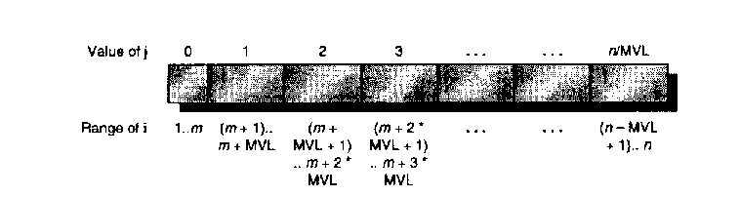
Example: Strip Mining
For the DAXPY loop, a we can generate a C code as below.
low=1; /*Assume start element at 1*/
vL = n % mvL; /*find the odd – size piece */
for(j=0; j<=n/mvL; j++){ /*Outer Loop*/
for(i=low; i<=low+vL-1;i++){ /*Inner loop-runs for length vL*/
y[i] = a*x[i] + y[i]; /*Start of next vector*/
}
low = low + vL; /*Find start of next vector*/
vL = mvL; /* reset length to max */
}

Slide 57
Common Vector Metrics
•R: MFLOPS rate on an infinite-length vector
  –Vector “speed of light”
  –Real problems do not have unlimited vector lengths, and the start-up penalties encountered in real problems will be larger
  –Rnis the MFLOPS rate for a vector of length n
•N1/2: The vector length needed to reach one-half of R
  –a good measure of the impact of start-up
•NV: The vector length needed to make vector mode faster than scalar mode
  –measures both start-up and speed of scalars relative to vectors, quality of connection of scalar unit to vector unit

Slide 58
Automatic Code Vectorization
for (i=0; i < N; i++)
C[i] = A[i] + B[i];
Scalar Sequential Code
Vectorized Code
load
load
load
Iter. 1
load
load
load
Time
add
add
add
store
store
store
load
Iter. 1
Iter. 2
Iter. 2
load
Vector Instruction
Vectorization is a massive compile-time reordering of operation sequencing
⇒ requires extensive loop dependence analysis
add
store

Slide 59
Vector Stride
Position of the elements we want in memory may not be sequential
Consider following code:
  Do 10 I=1, 100
    Do 10 j =1, 100
      A(I,j) = 0.0
      Do 10 k =1,100
  10 A(I,j) = A(I,j) + B(I,k)*C(k,j)
Matrix Data in Memory
X
X+5
X+10
X+15
X+20
If loop accesses data by column, vector loaded with non-sequential data

Slide 60
Vector Stride
Problem
  Position in memory of adjacent elements in may not be sequential. Set up time could be enormous.
  E.g. Matrix Multiplication.
Solution
  Distance seperating elements is called the Stride.
  Store the stride in a register, so only a single load or store is required.

Slide 61
Vector Stride
Access time
  Vector processors use interleave memory banks. Non-unit Strides can cause stalls.
  Stall will occur if
    No. of banks /LCM (Stride, No. of Banks)
    <
    Bank Busy time
  No conflicts if Stride and no. of banks are relatively prime.
  Increasing the no. of banks to greater than minimum.
  Most vector supercomputers have at least 64, with some having up to 1024.

Slide 62

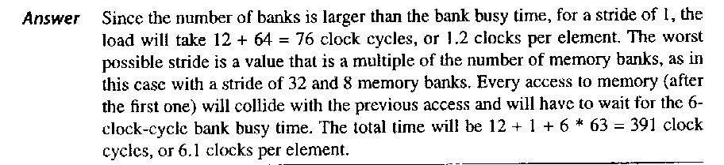
Example-Vector Stride

Slide 63
Effectiveness of Compiler Vectorization
•Two factors affect the success with which a programcan be run in vector mode
–The structure of the program itself
»have true data dependences?
»It is influenced by the algorithm chosenand, by
how they are coded
–Capability of the compiler
» There is tremendous variation in the ability of
compilers to determine whether a loop can be
vectorized
•The techniques used to vectorize programs are the same as those for uncovering ILP

Slide 64
Enhancing Vector Performance
In this section we present five techniques for improving the performance of a vector processor.
Chaining
Conditionally Executed Statements
Sparse Matrices
Multiple Lanes
Pipelined Instruction Start-Up
Notes:
The first, chaining, deals with making a sequence of dependent vector operations run faster, and originated in the Cray-1 but is now supported on most vector processors. The next two deal with expanding the class of loops that can be run in vector mode by combating the effects of conditional execution and sparse matrices with new types of vector instruction. The fourth technique increases the peak performance of a vector machine by adding more parallel execution units in the form of additional lanes. The fifth technique reduces start-up overhead by pipelining and overlapping instruction start-up.

Slide 65
Optimization 1: Chaining
Suppose:
vmul.vv V1,V2,V3
vadd.vv V4,V1,V5 # RAW hazard
Chaining
  Vector register (V1) is not as a single entity but as a group of individual registers
  Pipeline forwarding can work on individual vector elements
Flexible chaining: allow vector to chain to any other active vector operation => more read/write ports
Unchained
vmul
vadd
vmul
Chained
vadd

Slide 66
Vector Chaining
the Concept of Forwarding Extended to Vector Registers
Vector version of register bypassing
  introduced with Cray-1
V1
V2
V3
V4
V5
LV v1
MULV v3,v1,v2
ADDV v5, v3, v4
Chain
Chain
Load Unit
Mult.
Add
Memory
Notes:
Chaining allows a vector operation to start as soon as the individual elements of its vector source operand become available:
The results from the first functional unit in the chain are “forwarded” to the second functional unit.

Slide 67
向量链接技术
1、向量指令的类型
  以CRAY-1向量处理机为例，有四类指令，两种指令格式
  (1) 向量与向量操作， Vi←Vj OP Vk
  (2) 向量与标量操作， Vi ← Sj OP Vk
  (3) 向量取， Vi←存储器
  (4) 向量存， 存储器← Vi
2、向量运算中的相关和冲突
  向量运算中的数据相关和功能部件冲突：
  采用顺序发射顺序完成方式
  (1) 写读数据相关。
  (2) 读读数据相关，或向量寄存器冲突。
  (3) 运算部件冲突。

Slide 68
提高向量处理机性能的常用技术
链接技术
向量指令的类型：
S_{j}
1
Vj
1
2
2
3
3
4
4
V_{k}
V_{k}
…
…
n
n
Vi
Vi
第一类向量指令
第二类向量指令

Slide 69
存储器
1
Vi
1
2
2
3
3
4
4
5
Vi
5
6
存储器
6
7
7
第三类向量指令
第四类向量指令

Slide 70
向量运算中的相关和冲突
  向量运算中的数据相关和功能部件冲突：
  采用顺序发射顺序完成方式
  (1) 写读数据相关。
  (2) 读读数据相关，或向量寄存器冲突。
  (3) 运算部件冲突。
向量寄存器使用冲突：是指并行工作的向量指令中的源向量或结果向量使用相同的向量寄存器。例如：
V4←V1＋V2 V5←V1＋V2
V5←V2∧V3 V5←V3∧V4
左面一组中两条向量指令的一个源向量都使用V2寄存器，就出现了向量寄存器使用冲突。类似地右面一组中，两条向量指令的结果向量都使用V5寄存器，故有结果向量寄存器使用冲突。
上述二例中，两条指令都不能同时执行，必须在第一条指令执行完后，才能开始执行第二条指令。这是因为：以左面一组为例，两条指令中使用V2时的首元素下标可能不同，向量长度可能不同，因而难以保证由V2同时向两条指令提供所需的源向量。

Slide 71
功能部件使用冲突：是指同一功能部件为多条并行工作的向量指令所使用。例如：
V3←V3＋V2
V6←V4＋V5
由于两条向量指令都使用同一个浮点加功能部件，因此发生了浮点加功能部件使用冲突。
在理想情况下，若有m个功能部件并行工作，可使运算速度提高m倍。但实际上，由于程序本身并行性有限，并可能发生上述两种冲突，因此能完全并行工作的功能部件数总是小于m。
V0 ← V1＋V2 V3 ← V1＋V2
V3 ← V4 * V5 V6 ← V4 +V5
(a) (b)
V3 ← V1＋V2 V0 ← V1＋V2
V6 ← V1*V5 V3 ← V1 + V5
(c) (d)
(a)不相关的指令
(b)功能部件的预定
(c) 操作数寄存器预定
(d)功能部件和操作数寄存器的预定

Slide 72
3、向量链接技术(chaining)
  结果寄存器可能成为后继指令的操作数寄存器
  两条有RAW数据相关的向量指令并行执行，这种技术称为两条流水线的链接技术。
      例如：有如下3条向量指令：
      V3 ← A
      V2 ← V0＋V1
      V4 ← V2×V3
      第一、二条指令没有数据相关和功能部件冲突，可以同时开始执行。第三条指令与第一、二条指令均存在写读数据相关，可以链接执行。

Slide 73
浮点加
1
2
3
4
5
6
浮点乘
1
2
3
4
5
6
7
Mem
V0
V1
V2
V3
V4
1
2
3
4
5
6

Slide 74
    三种执行方式比较：
      (1) 如果向量长度为N，三条指令采用串行方法执行的时间为：
      [(1+6+1)+N-1]+[(1+6+1)+N-1]+[(1+7+1)+N-1] = 3N+22 拍
      (2) 如果前两条指令并行执行，第三条指令串行执行，则执行时间为：
      [(1+6+1)+N-1]+[(1+7+1)+N-1]
      = 2N+15 拍
      (3) 如果采用链接技术，则执行时间为：
      (1+6+1)+(1+7+1)+(N-1)=17+N-1=N+16 拍

Slide 75
    实现链接的条件：
      (1) 没有向量寄存器冲突和运算部件冲突。
      (2) 只有第一个结果送入向量寄存器的那一个周期可以链接。
      (3) 先行的两条指令产生运算结果的时间必须相等。
      (4) 两条向量指令的向量长度必须相等。

Slide 76
Vector Chaining Advantage
Without chaining, must wait for last element of result to be written before starting dependent instruction
Load
Mul
Time
Add
With chaining, can start dependent instruction as soon as first result appears
Load
Mul
Add

Slide 77
Implementations of Chaining
Early implementations worked like forwarding, but this restricted the timing of the source and destination instructions in the chain.
Recent implementations use flexible chaining, which requires simultaneous access to the same vector register by different vector instructions, which can be implemented either by adding more read and write ports or by organizing the vector-register file storage into interleaved banks in a similar way to the memory system.
Notes:
柔性链接

Slide 78
Optimization 2: Multi-lane Implementation
Pipelined
Datapath
Lane
Vector Reg.
Partition
Functional
Unit
To/From Memory System
Elements for vector registers interleaved across the lanes
Each lane receives identical control
Multiple element operations executed per cycle
Modular, scalable design
No need for inter-lane communication for most vector instructions

Slide 79
Multiple Lanes
ADDV C,A,B
Vector Instruction Execution
Execution using one pipelined functional unit
Execution using four pipelined functional units
A[6]
B[6]
A[24]
B[24]
A[25]
B[25]
A[26]
B[26]
A[27]
B[27]
A[5]
B[5]
A[20]
B[20]
A[21]
B[21]
A[22]
B[22]
A[23]
B[23]
A[4]
B[4]
A[16]
B[16]
A[17]
B[17]
A[18]
B[18]
A[19]
B[19]
A[3]
B[3]
A[12]
B[12]
A[13]
B[13]
A[14]
B[14]
A[15]
B[15]
C[2]
C[8]
C[9]
C[10]
C[11]
C[1]
C[4]
C[5]
C[6]
C[7]
C[0]
C[0]
C[1]
C[2]
C[3]
Notes:
The parallel semantics of a vector instruction allows an implementation to execute these elemental operations using :
either a deeply pipelined functional unit, or by using an array of parallel functional units, or a combination of parallel and pipelined functional units.
Using multiple functional units to improve the performance of a single vector add instruction
The machine shown in (a) has a single add pipeline and can complete one addition per cycle.
The machine shown in (b) has four add pipelines and can complete four additions per cycle.

Slide 80
Vector Unit Structure
Functional Unit
Vector
Registers
Elements 0, 4, 8, …
Elements 1, 5, 9, …
Elements 2, 6, 10, …
Elements 3, 7, 11, …
Lane
Memory Subsystem
Notes:
As with a traffic highway, we can increase the peak throughput of a vector unit by adding more lanes.
The structure of a four-lane vector unit is shown in Figure.
The vector-register storage is divided across the lanes, with each lane holding every fourth element of each vector register.
There are three vector functional units shown, an FP add, an FP multiply, and a load-store unit. Each of the vector arithmetic units contains four execution pipelines,
one per lane, that act in concert to complete a single vector instruction.

Slide 81
Chaining & Multi-lane Example
Scalar
LSU
FU0
FU1
vld
vmul.vv
vadd.vv
addu
vld
vmul.vv
vadd.vv
addu
Time
Element Operations:
Instr. Issue:
VL=16, 4 lanes, 2 FUs, 1 LSU, chaining -> 12 ops/cycle
Just one new instruction issued per cycle !!!!

Slide 82
Optimization 3: Vector Conditional Execution
Problem: Want to vectorize loops with conditional code:
      for (i=0; i<N; i++)
      if (A[i]>0) then
      A[i] = B[i];
Solution: Add vector mask (or flag) registers
  vector version of predicate registers, 1 bit per element
…and maskable vector instructions
  vector operation becomes NOP at elements where mask bit is clear
Code example:
  CVM ; Turn on all elements
  LV VA, RA ; Load entire A vector
  L.D F0,#0 ; Load FP zero into F0
  SGTVS.D VA, F0 ; Set bits in mask register where A>0
  LV VA, RB ; Load B vector into A under mask
  SV VA, RA ; Store A back to memory under mask
Notes:
This loop cannot normally be vectorized because of the conditional execution of the body;
however, if the inner loop could be run for the iterations for which A(i) <= 0, then the loop could be vectorized.
Conditionally executed instructions could turn such control dependences into data dependences, enhancing the ability to parallelize the loop.

Slide 83
Masked Vector Instructions
Simple Implementation
  execute all N operations, turn off result writeback according to mask
Density-Time Implementation
  scan mask vector and only execute elements with non-zero masks
M[7]=1
A[7]
B[7]
M[7]=1
M[6]=0
A[6]
B[6]
M[6]=0
A[7]
B[7]
M[5]=1
A[5]
B[5]
M[5]=1
M[4]=1
A[4]
B[4]
M[4]=1
M[3]=0
A[3]
B[3]
M[3]=0
C[5]
M[2]=0
C[4]
M[1]=1
M[2]=0
C[2]
M[0]=0
M[1]=1
C[1]
C[1]
Write data port
M[0]=0
C[0]
Write Enable
Write data port

Slide 84
Compress/Expand Operations
Compress packs non-masked elements from one vector register contiguously at start of destination vector register
  population count of mask vector gives packed vector length
Expand performs inverse operation
M[7]=1
A[7]
A[7]
A[7]
M[7]=1
M[6]=0
A[6]
A[5]
B[6]
M[6]=0
M[5]=1
A[5]
A[4]
A[5]
M[5]=1
M[4]=1
A[4]
A[1]
A[4]
M[4]=1
M[3]=0
A[3]
A[7]
B[3]
M[3]=0
M[2]=0
A[2]
A[5]
B[2]
M[2]=0
M[1]=1
A[1]
A[4]
A[1]
M[1]=1
M[0]=0
A[0]
A[1]
B[0]
M[0]=0
Compress
Expand
Used for density-time conditionals and also for general selection operations

Slide 85
Optimization 4: Sparse Matrices
•Sparse matrices cannot be efficiently implemented using so far techniques (e.g.lack of vectorization for SPICE)
•In a sparse matrix, the elements of a vector are usually stored in some compacted fromand then accessed indirectly
•Suppose:A and C are sparse vectors
  do100 i = 1,n
  100A(K(i)) = A(K(i)) + C(M(i))
•Representation of sparse matrices
  –Using index vectors(e.g. K and M) to designate the nonzero elements of sparse matrices, or
  –Using a bit vectorto say which elements exist and a dense vectorfor the nonzero elements
•Scatter-gather operation
  –Gather (LVI) operation takes an index vectorand fetches the vector whose elements are at the addresses given by adding a base address to the offsets given in the index vector => anonsparsevector in a vector regiter
  -After these elements are operated on in dense form, the sparse vector can be stored in expanded form by a scatter (SVI)store, using the same index vector

Slide 86
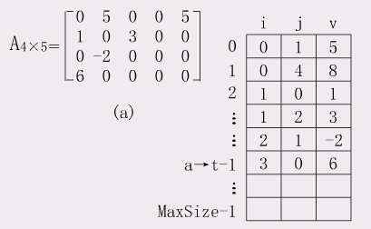
Sparse Matrices
Notes:
当二维数组A[m][n]有k个非零元素，若k<<m*n，则称A为稀疏矩阵。矩阵中大多数元素为零 。
In a sparse matrix, the elements of a vector are usually stored in some compacted form and then accessed indirectly.
三元组表

Slide 87
Vector Scatter/Gather
Want to vectorize loops with indirect accesses:
(index vector D designate the nonzero elements of C)
  for (i=0; i<N; i++)
  A[i] = B[i] + C[D[i]]
Indexed load instruction (Gather)
  LV VD, RD ; Load indices in D vector
  LVI VC,(RC, VD) ; Load indirect from RC base
  LV VB, RB ; Load B vector
  ADDV.D VA, VB, VC ; Do add
  SV VA, RA ; Store result
Notes:
下标向量D表示C的非零元素。
The primary mechanism for supporting sparse matrices is scatter-gather operations using index vectors. 分散集中操作
The goal of such operations is to support moving between a dense representation (i.e., zeros are not included) and normal representation (i.e., the zeros are included) of a sparse matrix.
A gather operation takes an index vector and fetches the vector whose elements are at the addresses given by adding a base address to the offsets given in the index vector. The result is a nonsparse vector in a vector register.

Slide 88
Vector Scatter/Gather
Scatter example:
  for (i=0; i<N; i++)
  A[B[i]]++;
Is following a correct translation?
  LV VB, RB ; Load indices in B vector
  LVI VA,(RA, VB) ; Gather initial A values
  ADDV VA, RA, 1 ; Increment
  SVI VA,(RA, VB) ; Scatter incremented values
Notes:
After these elements are operated on in dense form, the sparse vector can be stored in expanded form by a scatter store, using the same index vector.

Slide 89
Optimization 5: Pipelined Instruction Start-Up
The simplest case to consider is when two vector instructions access a different set of vector registers.
For example, in the code sequence
ADDV.D V1,V2,V3
ADDV.D V4,V5,V6
It becomes critical to reduce start-up overhead by allowing the start of one vector instruction to be overlapped with the completion of preceding vector instructions.
An implementation can allow the first element of the second vector instruction to immediately follow the last element of the first vector instruction down the FP adder pipeline.
Notes:
Adding multiple lanes increases peak performance, but does not change start-up latency, and so it becomes critical to reduce start-up overhead by allowing the start of one vector instruction to be overlapped with the completion of preceding vector instructions.
The simplest case to consider is when two vector instructions access a different set of vector registers.

Slide 90
Vector Startup
Two components of vector startup penalty
  functional unit latency (time through pipeline)
  dead time or recovery time (time before another vector instruction can start down pipeline)
Functional Unit Latency
R
X
X
X
W
R
X
X
X
W
First Vector Instruction
R
X
X
X
W
R
X
X
X
W
R
X
X
X
W
Dead Time
R
X
X
X
W
R
X
X
X
W
R
X
X
X
W
Dead Time
R
X
X
X
W
Second Vector Instruction
R
X
X
X
W
Notes:
some vector machines require some recovery time or dead time in between two vector instructions dispatched to the same vector unit.

Slide 91
Dead Time and Short Vectors
No dead time
4 cycles dead time
T0, Eight lanes
No dead time
100% efficiency with 8 element vectors
64 cycles active
Cray C90, Two lanes
4 cycle dead time
Maximum efficiency 94% with 128 element vectors

Slide 92
Example The Cray C90 has two lanes but requires 4 clock cycles of dead time between any two vector instructions to the same functional unit. For the maximum vector length of 128 elements, what is the reduction in achievable peak performance caused by the dead time? What would be the reduction if the number of lanes were increased to 16?
Answer A maximum length vector of 128 elements is divided over the two lanes and occupies a vector functional unit for 64 clock cycles. The dead time adds another 4 cycles of occupancy, reducing the peak performance to 64/(64 + 4) = 94.1% of the value without dead time.
If the number of lanes is increased to 16, maximum length vector instructions will occupy a functional unit for only 128/16 = 8 cycles, and the dead time will reduce peak performance to 8/(8 + 4) = 66.6% of the value without dead time.

Slide 93
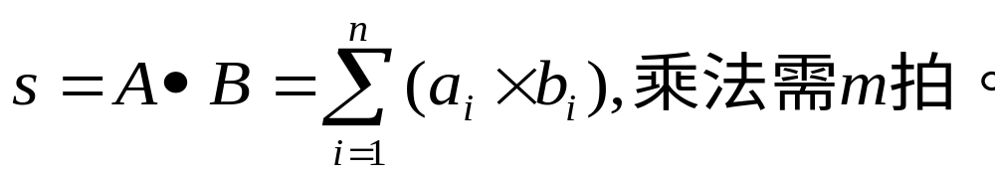

加速向量归约操作
应用举例：
实现方法一： （正常方法）
(1) C=A×B； --流水（向量）操作
(2) 对C进行递归折叠求和。--串行（循环）操作
实现方法二： （加速方法）
(1) C=A×B； --流水（向量）操作
(2) D=D C； --归约操作

Slide 94
归约实现方法： （V0←V0 C）
(1)置V0各分量为0(乘法为1)，V0和C计数器均为0；
(2)V0读计数器为0，直到第一个结果分量出来，V0写和C读计数器每时钟加1，直到等于向量计算长度为止。
假设： 指令通过功能部件时钟数为8个时钟周期。

Slide 95
t₀
t₈
t₁₆
t₆₃
V0₀,C₀
V0₀=C₀
V0₀,C₁
V0₁=C₁
…
V0₀,C₇
V0₇=C₇
V0₀,C₈
V0₈=C₀+C₈
V0₁,C₉
V0₉=C₁+C₉
…
V0₇,C₁₅
V0₁₅=C₇+C₁₅
…
…
V0₄₈,C₅₆
V0₅₆=C₀+C₈+…+C₅₆
V0₄₉,C₅₇
V0₅₇=C₁+C₉+…+C₅₇
…
V0₅₅,C₆₃
V0₆₃=C₇+C₁₅+…+C₆₃
结果： V0的最后8个分量为C₀至C₆₃之和。
(3) 对V0的最后p个(n/m)分量累加求和即可。
方法一 T₂=n*m，
方法二 T₂=(1+m+n)+(n/m)*m=2n+m+1。

Slide 96
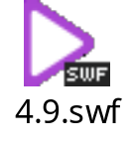
采用多处理机系统结构
前面所讲的三种技术措施都是在单处理机结构的向量计算机上实现的。为了更有效地提高向量处理性能，新型向量机采用了多处理机系统结构。
CRAY-1是单处理机系统结构的向量计算机，诞生于20世纪70年代中期，时钟周期为12.5ns。8 0年代推出的CRAY-2、CRAY X-MP，90年代推出的CRAY Y-MP、C90，基本上仍保持了CRAY-1的基本系统结构，但是它们已发展成为多处理机的系统结构。例如CRAY-2发展成为4个向量处理机，时钟周期缩短到4.1ns，运算速度提高到480MIPS，浮点运算最高可达1800MFLOPS。CRAY Y-MP，C90最多可以有16个向量处理机。
CRAY X-MP的结构由4个CPU组成。CPU的结构同CRAY-1向量处理机相似。

Slide 97
向量化编译技术
一、向量化基本功能
1.并行性检测
是否可用向量表示。
是否存在相关、条件语句、操作数的间接访问等。
2.并行性表示与开发
用向量指令代替循环，用屏蔽向量实现条件判断。
指令系统具有向量功能，编译程序支持向量操作。

Slide 98
二、向量化编译优化
1.通用优化方法
公共子表达式消除、常数调入、复制语句传递等。
2.循环体优化
固定表达式移出、归约变量消除，向量指令表示等。
3.向量寄存器优化分配
重新分配向量寄存器，减少向量寄存器使用冲突。
4.向量指令并行化
重新排序向量指令，减少流水功能转换频率，争取功能部件并行操作、向量指令链接。

Slide 99
三、向量处理带宽问题处理
多条向量流水同时进行，要求存储器带宽较大。
解决：可以通过多体交叉存储器和多层次存储系统实现。
向量指令中分量步长可变，向量存储满足按行、列、对角线等方式访问。
解决：根据存储体数量或互连网络决定向量的存储方式。
I/O带宽与存储器带宽的协调。

Slide 100
Applications
Limited to scientific computing?
Multimedia Processing (compress., graphics, audio synth, image proc.)
Standard benchmark kernels (Matrix Multiply, FFT, Convolution, Sort)
Lossy Compression (JPEG, MPEG video and audio)
Lossless Compression (Zero removal, RLE, Differencing, LZW)
Cryptography (RSA, DES/IDEA, SHA/MD5)
Speech and handwriting recognition
Operating systems/Networking (memcpy, memset, parity, checksum)
Databases (hash/join, data mining, image/video serving)
Language run-time support (stdlib, garbage collection)
even SPECint95
Notes:
43

Slide 101
6.4 向量处理机实例
向量处理机主要出自美国和日本。
美国著名的向量计算机公司有：CRAY、CDC、TI等
日本公司有：NEC、Fujitsu、Hitachi等

Slide 102
CRAY Y-MP向量处理机
  Cray Y-MP 816由1至8台处理机组成，多个处理机共享中央存储器、I/O子系统、处理机通信子系统和实时钟。
  中央存储器由256个交叉访问的存储体组成。每个处理机对4个存储器端口的交叉访问。CPU的时钟周期为6ns。
  4个存储器端口允许处理机同时执行两个标量和向量取操作、一个存储操作和一个独立的I/O操作。

Slide 103
      每个CPU由14个功能部件组成，分为向量、标量、地址和控制四个子系统。
      使用了大量地址寄存器、标量寄存器、向量寄存器、中间寄存器和临时寄存器。
      可以实现功能流水线灵活的链接。
      I/O子系统支持三类通道，传输速率分别为6兆字节/秒，100兆字节/秒和1G字节/秒。

Slide 104
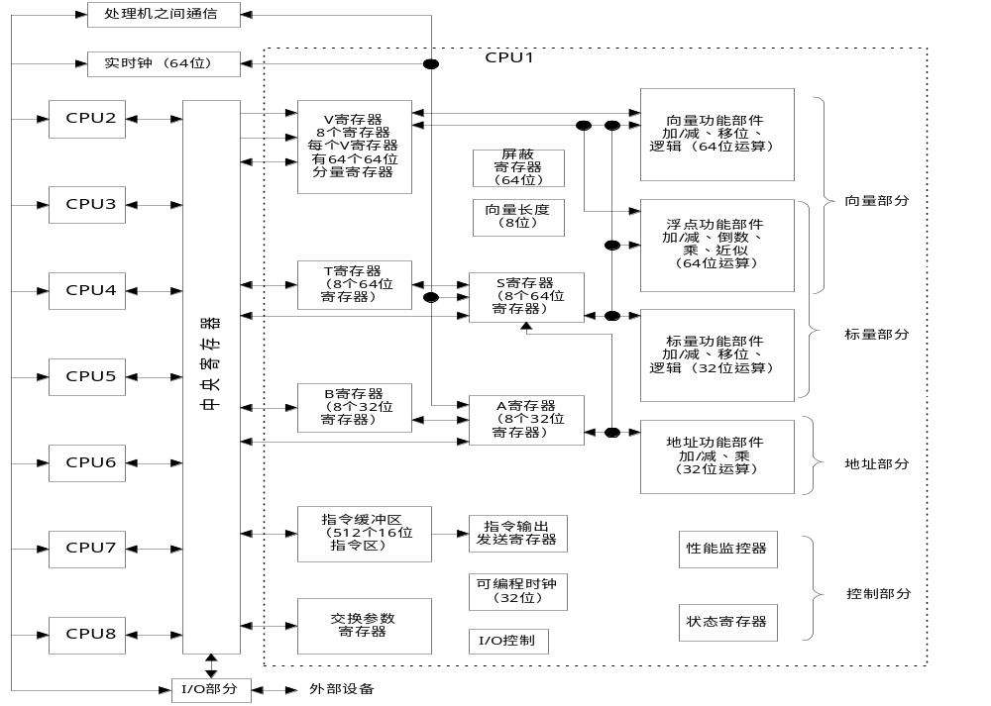

Slide 105
向量协处理器
以通用中小型机，或微机作为主机；向量处理部件作为外围设备，加速向量的处理速度。
向量协处理器是为中小型用户设计的，解决科学计算中大量向量处理任务的一种装置。
与各种不同主机相连的向量协处理器，价格和功能的变化范围很大。
FPS-164是最典型的向量协处理器，美国浮点系统公司生产。每个向量处理器有两个乘加部件，两组向量寄存器，两组标量寄存器。

Slide 106
每个乘加部件每个周期能输出一个结果。
向量寄存器：2组?4个?２Ｋ个操作数，每个操作数４个字节。
运算过程：标量处理器把原始数据装入向量寄存器，把标量数据和指令播送到全部向量处理器。向量处理器就同步地运算，但它们处理的数据是各不相同的。
向量操作可以和标量处理器中的标量操作同时进行。
向量协处理器特别适合于大规模的数值处理，用户购买需要台数的向量处理器，使用现有的处理机作为主机。

Slide 107
协处理器
主存储器
120 MB
标量寄存器
X寄存器组
Y寄存器组
标量运算部件
乘法流水线
加法流水线
地址寄存器
间址寄存器
与主计算
机连接
向量
寄存器
向量处理器
FPS-164向
量协处理
器结构图
向量处理器
向量处理器

Slide 108
Vector Execution Time: Chime Model
Vector execution time= func. (vector length, data dependencies, structural hazards)
Initiation rate: rate that FU consumes vector elements
(= number of lanes; usually 1 or 2 on Cray T-90)
Convoy: set of vector instructions that can begin execution in same clock(no structural or data hazards)
Chime: approximate time for a vector operation
mconvoys take mchimes
If each vector length is n, then they take approximate m⋅nclock cycles
  –ignores overhead
  –good approximation for long vectors

Slide 109

Vector Execution Time: Example
•Assuming a single copy of each VFU =>1lane •4conveys =>4 chimes, m=4
•For example, VL=64=>n=64
•m⋅n= 4 ⋅64 = 256 clocks
•=>4 clocks per result

Slide 110
Overhead: Start-up Time (1/2)
•Vector start-up time: pipeline latency time of the vector operation (determined by depth of FU pipeline)
  –another sources of overhead to make the convoy execution time morn than onechime
•Assume convoysdo not overlap佀the start-up time delays the execution of subsequent convoys
•The actual timeto complete a convoy is determined by the sumof the vector lengthand the start-up time
•Example(from CRAY-1) : Operation Start-up penalty
  –Vector load/store unit12 cycles
  –Vector multiply unit7 cycles
  –Vector add unit6 cycles

Slide 111
Overhead: Start-up Time (2/2)
•Assume vector length = n
Convoy Start 1st result last result
LV 0 12 11+n(=12+n-1)
MULTSV LV 12+n 12+n+12 23+n+nLoad start-up
ADDV 24+2n 24+2n+6 29+2n+n Wait convoy 2
SV 30+3n 30+3n+12 41+3n+nWait convoy 3

Slide 112
Why Startup Time for Each Vector Instruction?
•Why not overlap startup time of back-to-back vector instructions?
•Cray machinesbuilt from many ECL chips operating at high clock rates; hard to do?
•Berkeley vectordesign (“T0”) did not know it was not supposed to do overlap, so no startup times for functional units (except load)

Slide 113
Performance of Vector Processors
Vector Execution Time
The execution time of a sequence of vector operations primarily depends on three factors:
the length of the operand vectors
structural hazards among the operations
data dependences

Slide 114
Convoy and Chime
Convoy is the set of vector instructions that could potentially begin execution together in one clock period.
  The instructions in a convoy must not contain any structural or data hazards; if such hazards were present, the instructions in the potential convoy would need to be serialized and initiated in different convoys.
A chime is the unit of time taken to execute one convoy.
  A chime is an approximate measure of execution time for a vector sequence; a chime measurement is independent of vector length.
  A vector sequence that consists of m convoys executes in m chimes, and for a vector length of n, this is approximately m × n clock cycles.
Notes:
Although the concept of a convoy is used in vector compilers, no standard terminology exists. Hence, we created the term convoy.
Placing vector instructions into a convoy is analogous to placing scalar operations into a VLIW instruction.
Accompanying the notion of a convoy is a timing metric, called a chime, that can be used for estimating the performance of a vector sequence consisting of
convoys.
A chime approximation ignores some processor-specific overheads, many of which are dependent on vector length. Hence, measuring time in chimes is a better approximation for long vectors. We will use the chime measurement, rather than clock cycles per result, to explicitly indicate that certain overheads are being ignored.

Slide 115
Example Show how the following code sequence lays out in convoys, assuming a single copy of each vector functional unit:
LV V1,Rx ;load vector X
MULVS.D V2,V1,F0 ;vector-scalar multiply
LV V3,Ry ;load vector Y
ADDV.D V4,V2,V3 ;add
SV Ry,V4 ;store the result
How many chimes will this vector sequence take?
How many cycles per FLOP (floating-point operation) are needed, ignoring vector instruction issue overhead?

Slide 116
Answer The first convoy is occupied by the first LV instruction. The MULVS.D is dependent on the first LV, so it cannot be in the same convoy. The second LV instruction can be in the same convoy as the MULVS.D. The ADDV.D is dependent on the second LV, so it must come in yet a third convoy, and finally the SV depends on the ADDV.D, so it must go in a following convoy.
1. LV
    2. MULVS.D LV
    3. ADDV.D
    4. SV
The sequence requires four convoys and hence takes four chimes. Since the sequence takes a total of four chimes and there are two floating-point operations per result, the number of cycles per FLOP is 2 (ignoring any vector instruction issue overhead).

Slide 117
Start-up overhead
The most important source of overhead ignored by the chime model is vector start-up time.
The start-up time comes from the pipelining latency of the vector operation and is principally determined by how deep the pipeline is for the functional unit used.
Unit | Start-up overhead (cycles)
Load and store unit | 12
Multiply unit | 7
Add unit | 6

Slide 118
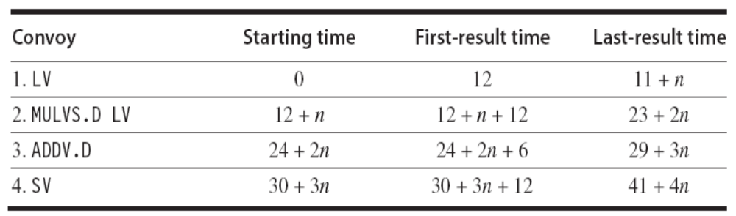
Example Assume the start-up overhead for functional units is shown in Figure of the previous page.
Show the time that each convoy can begin and the total number of cycles needed. How does the time compare to the chime approximation for a vector of length 64?
Answer
The time per result for a vector of length 64 is 4 + (42/64) = 4.65 clock cycles, while the chime approximation would be 4.

Slide 119
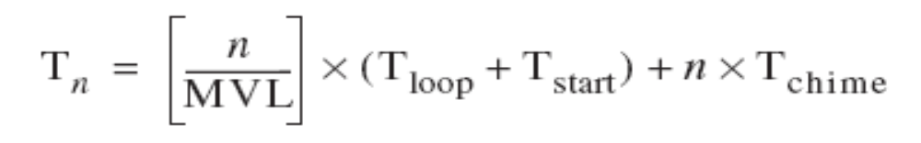
Running Time of a Strip-mined Loop
There are two key factors that contribute to the running time of a strip-mined loop consisting of a sequence of convoys:
1. The number of convoys in the loop, which determines the number of chimes. We use the notation Tchime for the execution time in chimes.
2. The overhead for each strip-mined sequence of convoys. This overhead consists of the cost of executing the scalar code for strip-mining each block, Tloop, plus the vector start-up cost for each convoy, Tstart.
the total running time for a vector sequence operating on a vector of length n:

Slide 120
Example What is the execution time on VMIPS for the vector operation A = B × s, where s is a scalar and the length of the vectors A and B is 200?
Answer
  Assume the addresses of A and B are initially in Ra and Rb, s is in Fs, and recall that for MIPS (and VMIPS) R0 always holds 0.
  The first iteration of the strip-mined loop will execute for a vector length of (200 mod 64) = 8 elements, and the following iterations will execute for a vector length of 64 elements.
  Since the vector length is either 8 or 64, we increment the address registers by 8 × 8 = 64 after the first segment and 8 × 64 = 512 for later segments. The total number of bytes in the vector is 8 × 200 = 1600, and we test for completion by comparing the address of the next vector segment to the initial address plus 1600.

Slide 121
Here is the actual code:
DADDUI R2,R0,#1600 ;total # bytes in vector
DADDU R2,R2,Ra ;address of the end of A vector
DADDUI R1,R0,#8 ;loads length of 1st segment
MTC1 VLR,R1 ;load vector length in VLR
DADDUI R1,R0,#64 ;length in bytes of 1st segment
DADDUI R3,R0,#64 ;vector length of other segments
Loop: LV V1,Rb ;load B
MULVS.D V2,V1,Fs ;vector * scalar
SV Ra,V2 ;store A
DADDU Ra,Ra,R1 ;address of next segment of A
DADDU Rb,Rb,R1 ;address of next segment of B
DADDUI R1,R0,#512 ;load byte offset next segment
MTC1 VLR,R3 ;set length to 64 elements
DSUBU R4,R2,Ra ;at the end of A?
BNEZ R4,Loop ;if not, go back

Slide 122
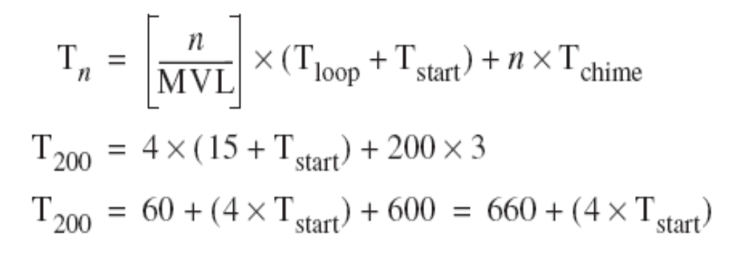
The three vector instructions in the loop are dependent and must go into three convoys, hence Tchime = 3.
Use our basic formula:
The value of Tstart is given by Tstart = 12 + 7 + 12 = 31
So, the overall value becomes T200 = 660 + 4 × 31= 784
The execution time per element with all start-up costs is then 784/200 = 3.9, compared with a chime approximation of three.
Notes:
The value of Tstart is the sum of
the vector load start-up of 12 clock cycles
a 7-clock-cycle start-up for the multiply
a 12-clock-cycle start-up for the store

Slide 123
6.5 向量处理机的性能评价
衡量向量处理机性能的主要指标有： 向量指令处理时间T_{vp}、 最大性能R¥、半性能向量长度n_{1/2}等。
1、向量指令处理时间T_{vp}
执行一条向量长度为n的向量指令的时间T_{vp}表示为：
T_{vp}＝T_{s} + T_{vf} + (n - 1) T_{c}
其中：T_{s}为向量流水线的建立时间。 T_{vf}为向量流水线的流过时间。 T_{c}为流水线“瓶颈”段的执行时间。
如果每段执行时间都等于一个时钟周期，则有：
T_{vp}＝[s + e + (n - 1)] t
其中：s为向量流水线建立时间所需的时钟周期数。e为向量流水线流过时间所需的时钟周期数。 n为向量长度。t为时钟周期长度。
把几条能在一个时钟周期内同时开始执行的向量指令称为一个编队，同一个编队中的指令一定不存在功能部件冲突和数据相关。

Slide 124
例1：假设一台向量处理机中功能部件的启动开销为：取数和存数部件为12个时钟周期、乘法部件为7个时钟周期、加法部件为6个时钟周期。先把序列向量操作分成编队，然后计算每个编队的开始时间、获得第一个结果元素的时间和获得最后一个结果元素的时间。
  LV V1， Rx ；取向量x
  MULTSV V2， F0， V1 ；向量和标量相乘
  LV V3， Ry ；取向量Y
  ADDV V4， V2， V3 ；加法
  SV Ry， V4 ；存结果
  解：第一条指令LV为第一个编队。MULTSV指令和第二条LV指令为第二个编队。ADDV指令为第三个编队。SV指令为第四个编队。
如果采用向量链接技术（不考虑访问存储器的冲突），
需要：12 + 7 + 6 + 12 + n – 1＝36 + n个周期。

Slide 125
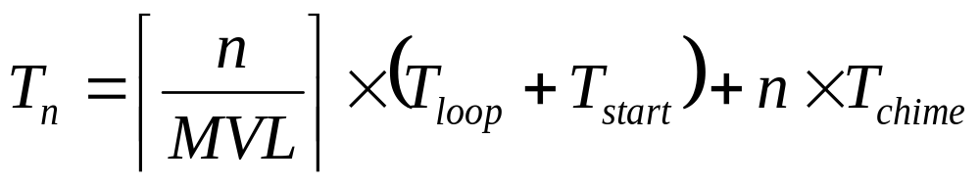
如果采用向量链接技术（不考虑访问存储器的冲突），
需要：12 + 7 + 6 + 12 + n – 1＝36 + n个周期。
如果考虑向量长度大于向量寄存器长度时，则需要分段开采。
向量长度为n的一组向量操作的整个执行时间为：
其中：T_{loop}为执行标量代码的开销，T_{start}为每个编队的向量启动开销，MVL是向量寄存器的长度。
T_{loop}可以看作是一个常数，Cray 1机的 T_{loop} 约等于15。
例2：在一台向量处理机上实现A＝B×s操作，其中A和B是长度为200的向量，s是一个标量。向量寄存器长度为64。各功能部件的启动时间与上例相同。求总的执行时间。

Slide 126
解：因为向量长度超过了向量寄存器的长度，所以要采取分段开采方法。每次循环主要由下面三条向量指令组成：
LV V1， Rb ；取向量B
MULTVS V2， V1， Fs ；向量和标量相乘
SV Ra， V2 ；存向量
假设A和B的分别放在Ra和Rb之中，s在Fs中。
三条指令之间存在有写读数据相关，因此必须把它们分成3个编队，T_{chime}= 3。
T₂₀₀＝4×(15 + T_{start}) + 200×3
＝60＋（4×T_{start}）+ 600
＝660＋（4×T_{start}）
其中：T_{start}=12 + 7 + 12 = 31，
因此，T₂₀₀＝660 + 4×31＝784
每个结果元素的平均这些时间为：768/200 ＝3.9个周期。

Slide 127
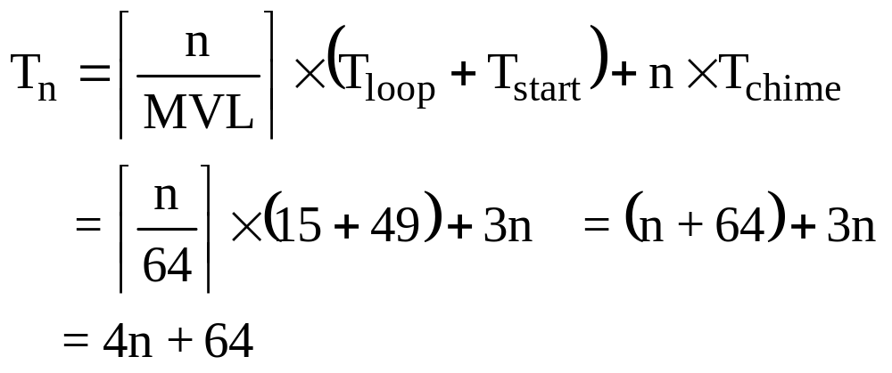
例3：在某台向量处理机上执行代码代码如下：
1：LV V1， Rx ；取向量x
2：MULTSV V2， F0， V1 ；向量和标量相乘
3：LV V3， Ry ；取向量Y
4：ADDV V4， V2， V3 ；加法
5：SV Ry， V4 ；存结果
考虑访问存储器冲突，向量寄存器长度为n、各功能部件的启动时间与上例相同。求总的执行时间。
解：指令1、2，指令3、4和指令5分成三个编队，前两个编队中两条指令采用向链接技术执行。
T_{chime}=3，T_{loop}=15，T_{start}=12+7+12+6+12=49，VL=64。

Slide 128
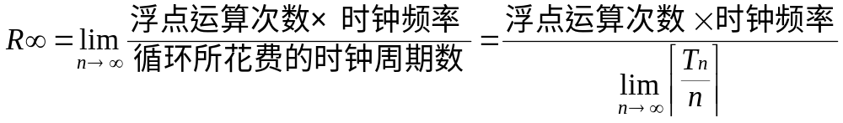
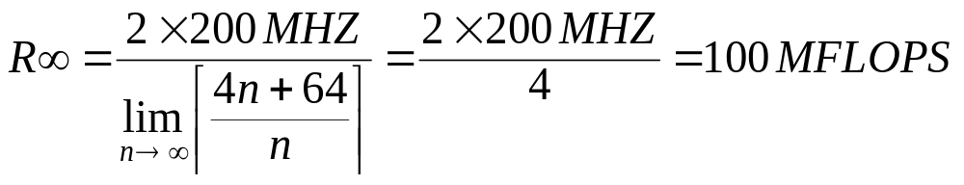
2、最大性能R¥
R¥表示当向量长度为无穷大时的向量流水线的最大性能。
常在评价峰值性能时使用，单位为MFLOPS。
最大性能R¥ 表示为：
其中：n为向量长度；
Tn为一组向量操作的整个执行时间。
对于某向量机，Tn=4n+64，假设时钟频率为200MHZ。每个循环有2个浮点操作：

Slide 129
3、半性能向量长度n_{1/2}
为达到一半R∞值所需的向量长度称为半性能向量长度n_{1/2}。
主要评价向量流水线建立时间对性能的影响。
CRAY-1的n_{1/2}＝10～20，CYBER 205的n_{1/2}＝100。
由MFLOPS定义可知：
对于例3，如果向量处理机的时钟频率为200MHz。
因为：R∞=100MFLOPS，因此有：
100／2 ＝ 2 n_{1/2}／Tn_{1/2} × 200
假设：n_{1/2} ≤ 64，因此：Tn_{1/2} ＝64 + 3 n_{1/2}
解得：100／2 ＝ 2 n_{1/2}／(64 + 3 n_{1/2}) × 200
    n_{1/2}＝12.8 所以：n_{1/2}＝13

Slide 130
6.7 向量处理机的发展
  1、向量计算机系统结构的发展趋势
    (1) 提供多种向量运算指令。
    (2) 除具有向量处理功能外还有其它功能。
    (3) 采用多层次的存储器系统。
    (4) 流水线技术与并行技术相结合。
  2、向量计算机系统结构要解决的六个技术问题：
    (1) 处理机带宽，两种方法：
    运算部件采用流水线结构。用多个运算器构成并行系统。
    (2) 存储器带宽，多种解决方法：
    用多个独立的存储体构造一个大容量的存储器系统。
    采用多层次的存储器系统提高访问速度。
    采用高速缓冲存储器和可寻址的寄存器组效果最好。
    采用流水线技术，存储系统的访问速度快5～20倍。

Slide 131
    (3) 输入／输出带宽
    许多高性能向量处理机配备10 ~ 29个DMA通道。
    (4) 通信带宽。共享存储器或互连网络。
    (5) 同步。多流水线结构通过控制程序使所有流水线同步工作。
    Cray-1系统采用流水线互锁来控制向量操作，不冲突的操作可以并行地执行，相关的操作尽可能链接起来重叠地进行。
    (6) 多用途。非数值计算问题。
  3、向量计算机系统结构的主要优点是：
    (1) 通过流水线存取方式有效地提高了存储器的带宽。
    (2) 流水结构的运算器有很高的性能价格比。
    (3) 非常简单的机制就能满足通信和同步的要求。
    向量处理机以Mflops (Million floating-point operations per second)作为速度单位。一般认为，标量计算机中执行一次浮点运算需２~５条指令，平均需３条指令。

Slide 132
    本 章 小 结
    向量流水处理机是指令级并行的另一类机器。这种机器能较好地发挥流水线技术的特性，可以达到较高的计算速度。本章介绍向量处理的基本概念，向量流水处理机的一般结构，提高向量流水处理机性能的常用技术，新型向量流水处理机。
    本章重点是：(1)三种向量处理方式；(2)存储器存储器结构，寄存器－寄存器结构；(3)链接技术。
    向量处理机是解决数值计算问题的一种重要的高性能结构，计算速度大于1000 MFLOPS。绝大多数向量处理机采用流水线结构，典型机器有CRAY系列和NECSX-X系列。
    对数组的运算称为向量处理，有3种处理方式。从并行性考虑，向量处理机中采用纵向处理方式和纵横向结合处理方式。
    向量计算机系统主要采用两种结构：(1)存储器－存储器结构，即利用N个独立的存储器模块来支持相对独立的数据的并发访问，从而达到所要求的存储器带宽。(2)寄存器－寄存器结构，即构造一个满足带宽要求的高速中间存储器，并能实现该高速中间存储器与主存储器之间的快速数据交换。
    提高向量处理机性能的常用技术是：(1)采用多功能部件以最大限度实现其并行工作；(2)采用链接技术，中间结果不必送回存储器，而且在向量操作完成以前就使用；(3)分段开采技术，将长向量分段成为向量循环结构；(4)采用多处理机结构，并行地处理多条流水线上独立无关的数据。
    向量处理机的主要性能参数有：向量指令的处理时间T_{VP}、向量处理机的最大性能R∞、半性能向量长度n_{1／2}等。

